Slide 2
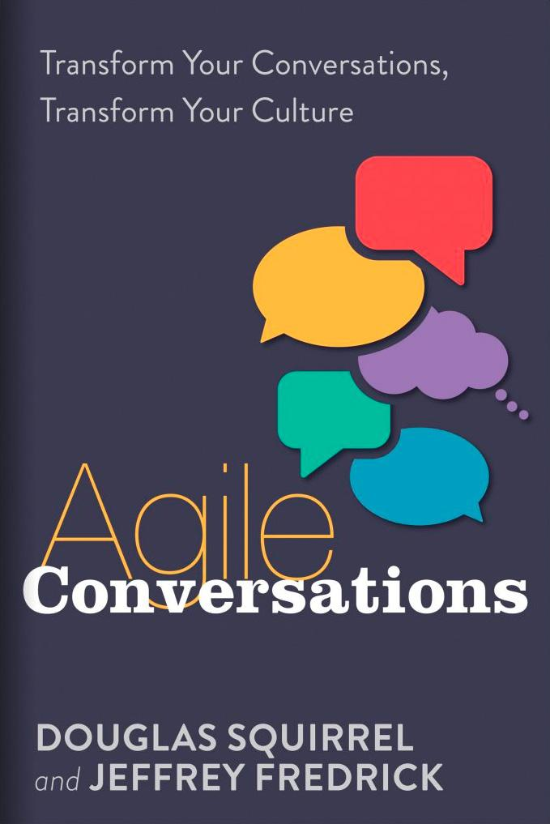
Agile Conversations Transform Your Conversations,
Transform Your Culture
Published: May 2020, IT Revolution Press
Available Now

Slide 3
“High-velocity organizations differ from low-velocity organizations both structurally and dynamically.”
“Structurally, they insist that each piece of work be done with an eye to the larger process of which it is a part. Dynamically, they insist that each piece of work be done in such a way as to bring problems to the attention of those who can best analyze and solve them.”
The High-Velocity Edge: How Market Leaders Leverage Operational Excellence to Beat the Competition Dr. Steven J. Spear, McGraw-Hill, 2009

Slide 4
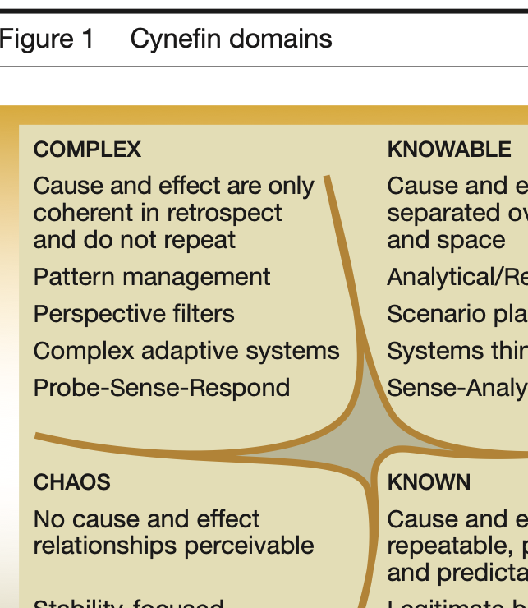
“Un-ordered domain: Complex relationships. … We have described elsewhere a range of methods designed to stimulate emergent patterns in complex knowledge interactions by increasing the number of perspectives available to a decision maker.”
The new dynamics of strategy: Sense-making in a complex and complicated world Kurtz & Snowden IBM Systems Journal, Vol 42, #3 2003

Slide 5

Making an Important
Decision
Imagine you and everyone here in the Slack channel are going to make an important decision together—for instance, the location of next year’s DOES conference.
How would you propose the group make the decision?
Please type your answer in Slack.

Slide 6
The Paradox of Espoused Behavior
All of you know what is required to get to a good decision:
Diversity is strength
Share ideas, facts, reasoning
Productive, collaborative conflict of ideas
And yet our actual behavior is different, especially when the stakes are high:
We want our idea to win
Differences are a threat
We don’t listen to others and don’t share all we know

Slide 7
Changing Your Culture
Start with a conversational transformation…
The good news is that there are tested, well-defined approaches to enabling organizational learning
Chris Argyris, Yale and Harvard professor, studied these questions
His answer (and ours) is to use conversations to become self-aware
When we change the conversations, we change the culture
This is a conversational transformation
…and you already know what the results look like!

Slide 8
Conversational Analysis with The 4 Rs
1 | Record
2 | Reflect
3.1 | Repeat
3 | Revise
4 | Roleplay
4.1 | Role-reversal

Slide 9
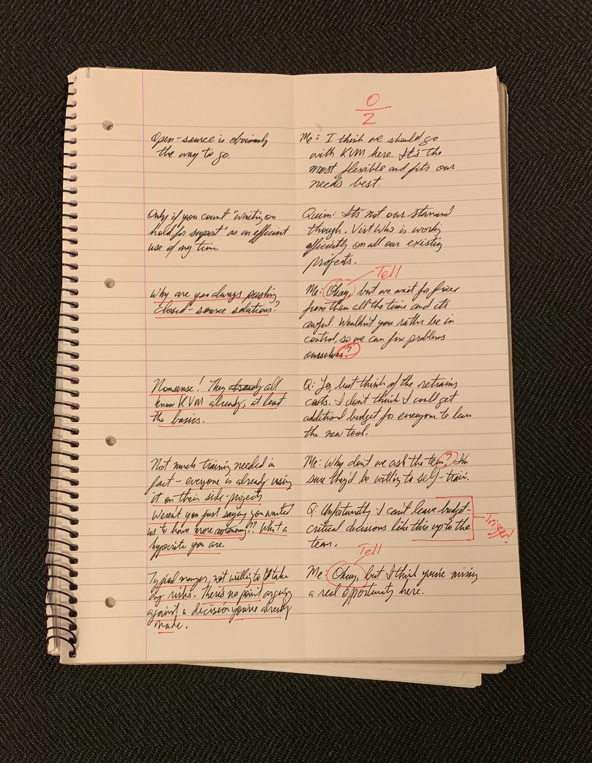
Record
Fold your paper in half.
On right, write what you and the other person said (transparency).
On left, write your inner dialog, what you thought and felt (curiosity).
No cheating, must be written down!

Slide 10
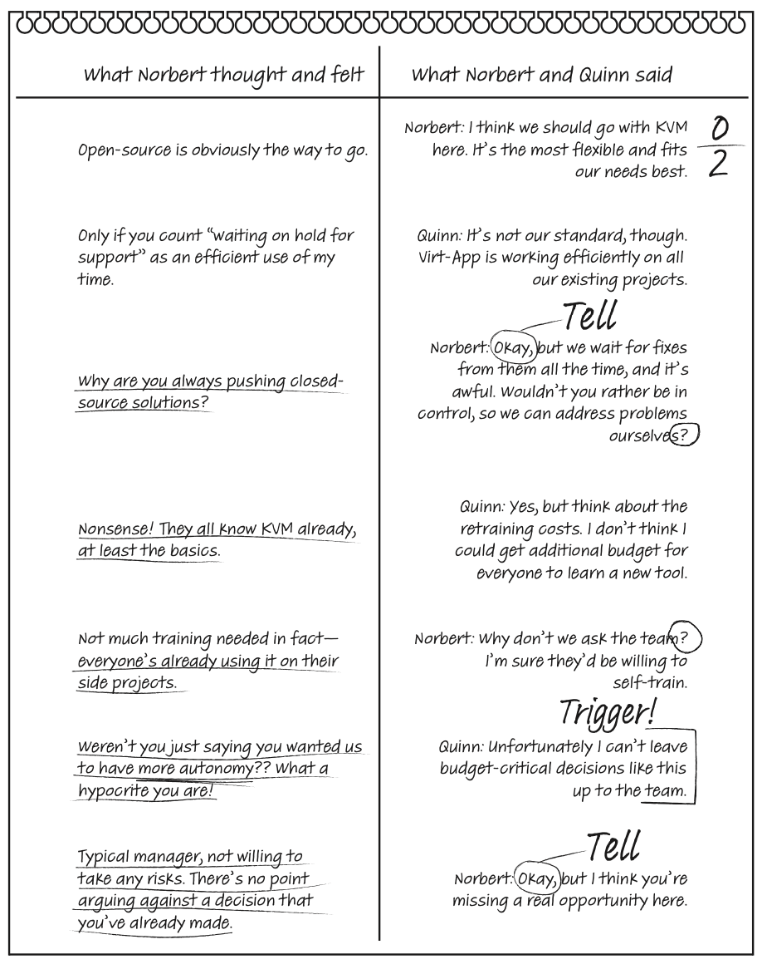
Question Fraction:
genuine questions over total questions
Reflect
Underline unshared thoughts & feelings
Notes:
Recording: Fold your paper in half.
On right, write what you and the other person said; on left, write your inner dialog, what you thought and felt.
No cheating, must be written down!
Scoring for Reflection: Curiosity: Low question fraction highlights low curiosity
Transparency: Lots of underlining on the left indicates low transparency

Slide 11
Revise
What Norbert thought and felt | What Norbert & Quinn said
Not much training needed in fact - everyone’s already using it on their side projects. | Norbert: Actually, almost everyone already knows KVM. I can check with them to be sure. Do you think that’s a good next step?
Weren’t you just saying you wanted us to have more autonomy?? This is one of my triggers, so I’ll try raising the issue of autonomy directly. | Quinn: It’s certainly good to get the information. But don’t let them think the choice has been made; unfortunately, I can’t leave budget-critical decisions like this up to the team.
I’m hopeful that we can have a meaningful discussion about increasing self-organization. | Norbert: You know, that doesn’t sit well with me, because I think we need more autonomy, not less. Can we talk more about how we make decisions?

Slide 12

Roleplay
Try roleplaying your conversation.
How does it sound? How does it feel? Sometimes it is awkward because it is poorly constructed, sometimes it is awkward because we lack practice. Roleplay can help with both.

Slide 13
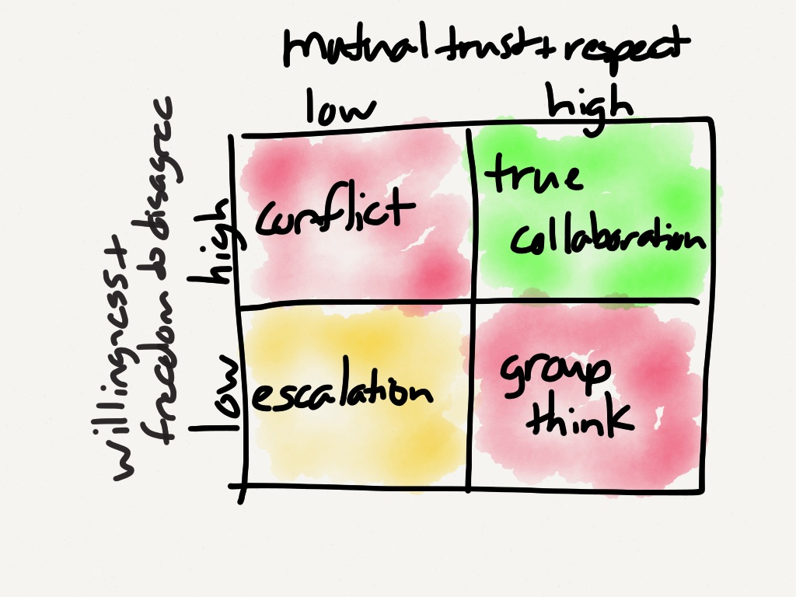
Image from The Uncanny Valley of a Functional Organization

Slide 14
Changing... Painfully
“What does being wrong feel like?” — Karen Schultz, On Being Wrong, TED2011
“Dreadful”
“Thumbs down”
“Great! I love to learn and get better.”
“This is going to require difficult emotional work” — Mark Coleman, A re-imagining of the term ‘full-stack developer’, Devopsdays Amsterdam 2015
Learning is the detection and correction of error
We are going to be learning about ourselves
#LearningIsHorrible

Slide 15
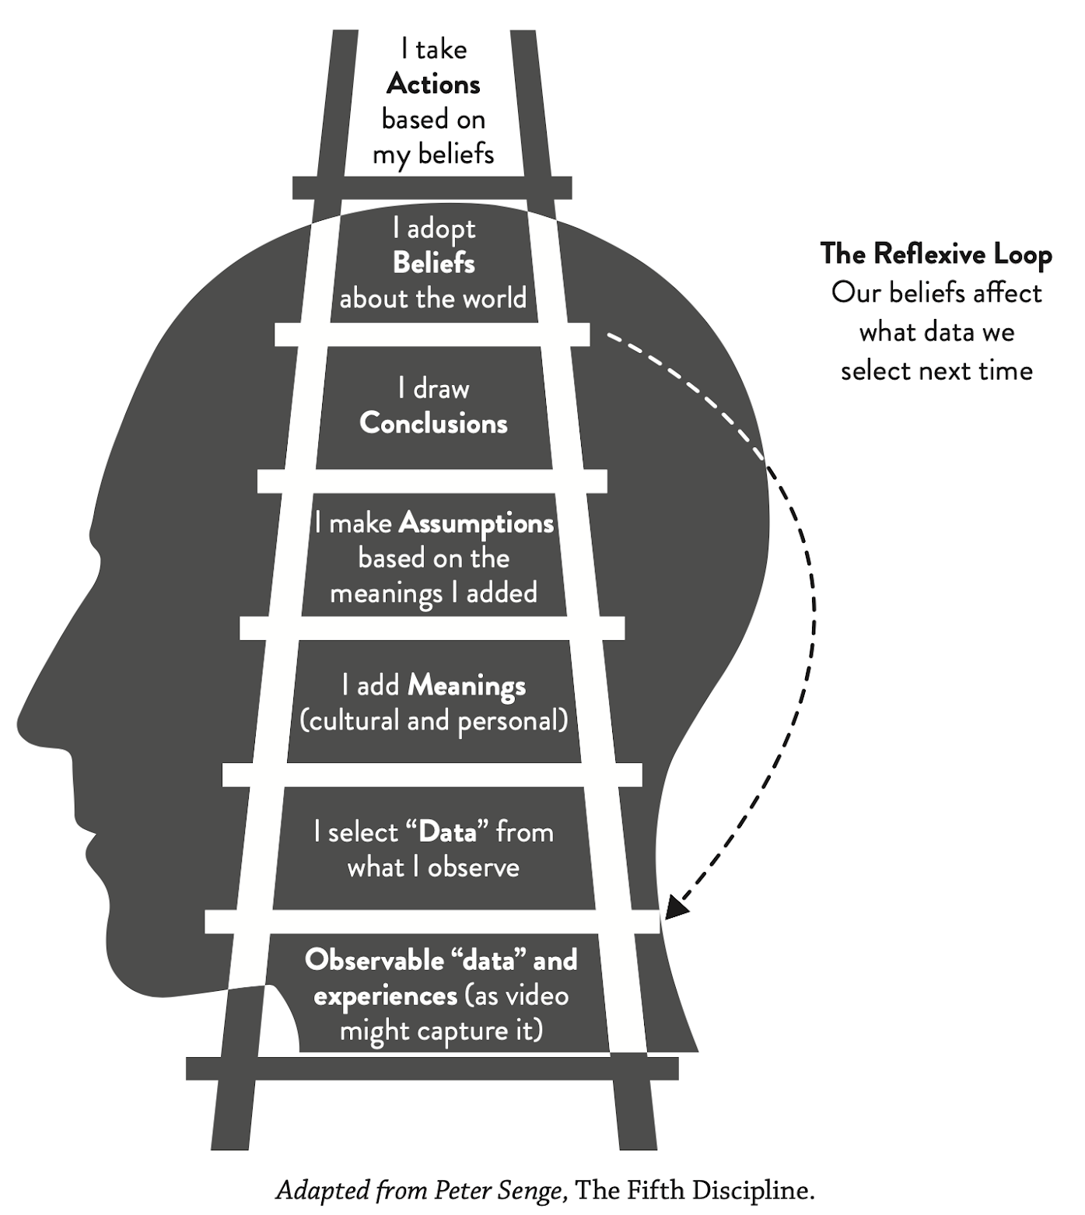
Dojos help you develop skills faster
Skill development is faster with deliberate practice
Regular dojo sessions are like regular gym sessions. You build your conversational muscles faster.
Group practice is more effective
Thanks to “self-distancing”, other people can see into our blind spots, giving us more opportunities to learn. And we learn through helping others.
Practicing with others is more fun!

Slide 16
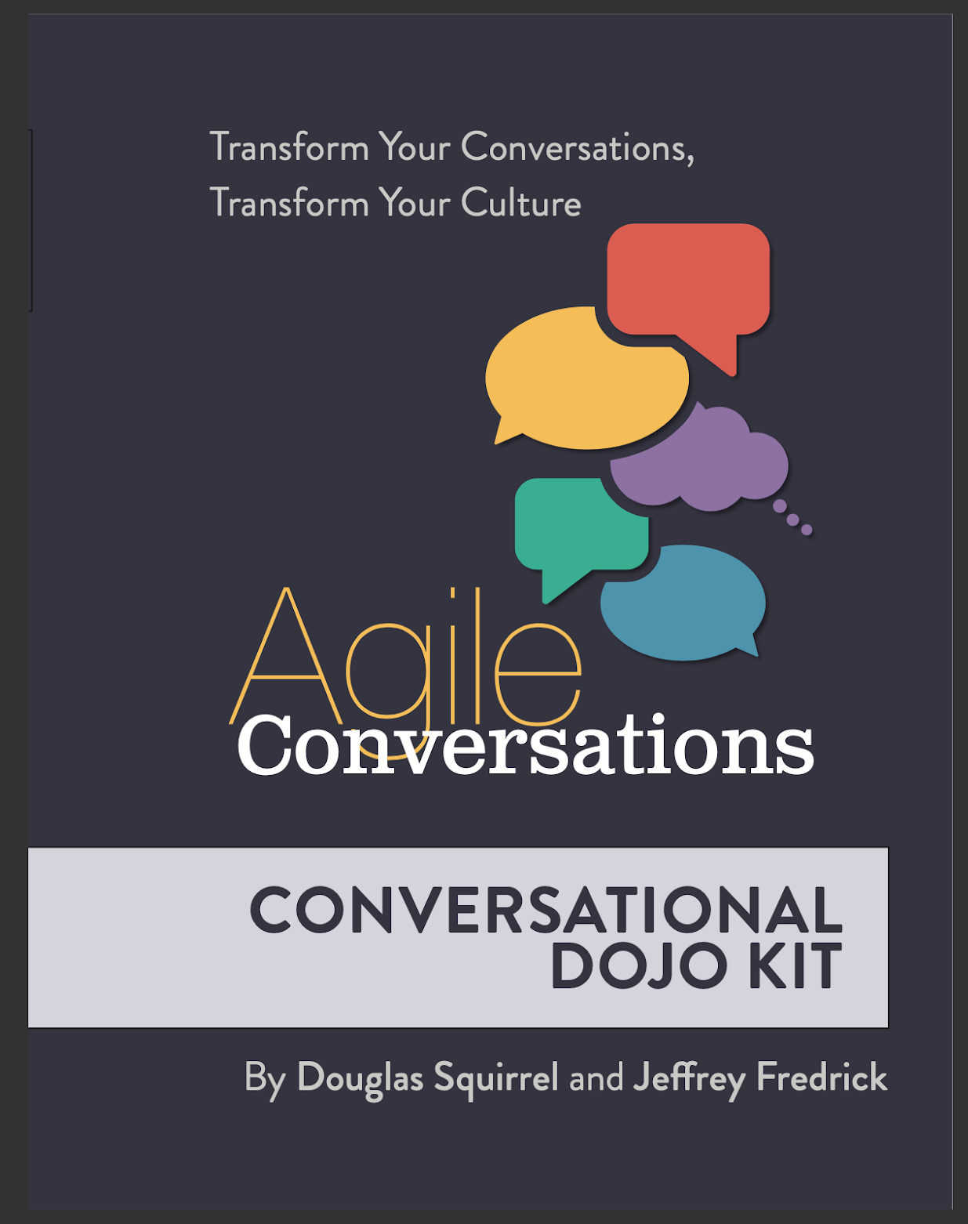
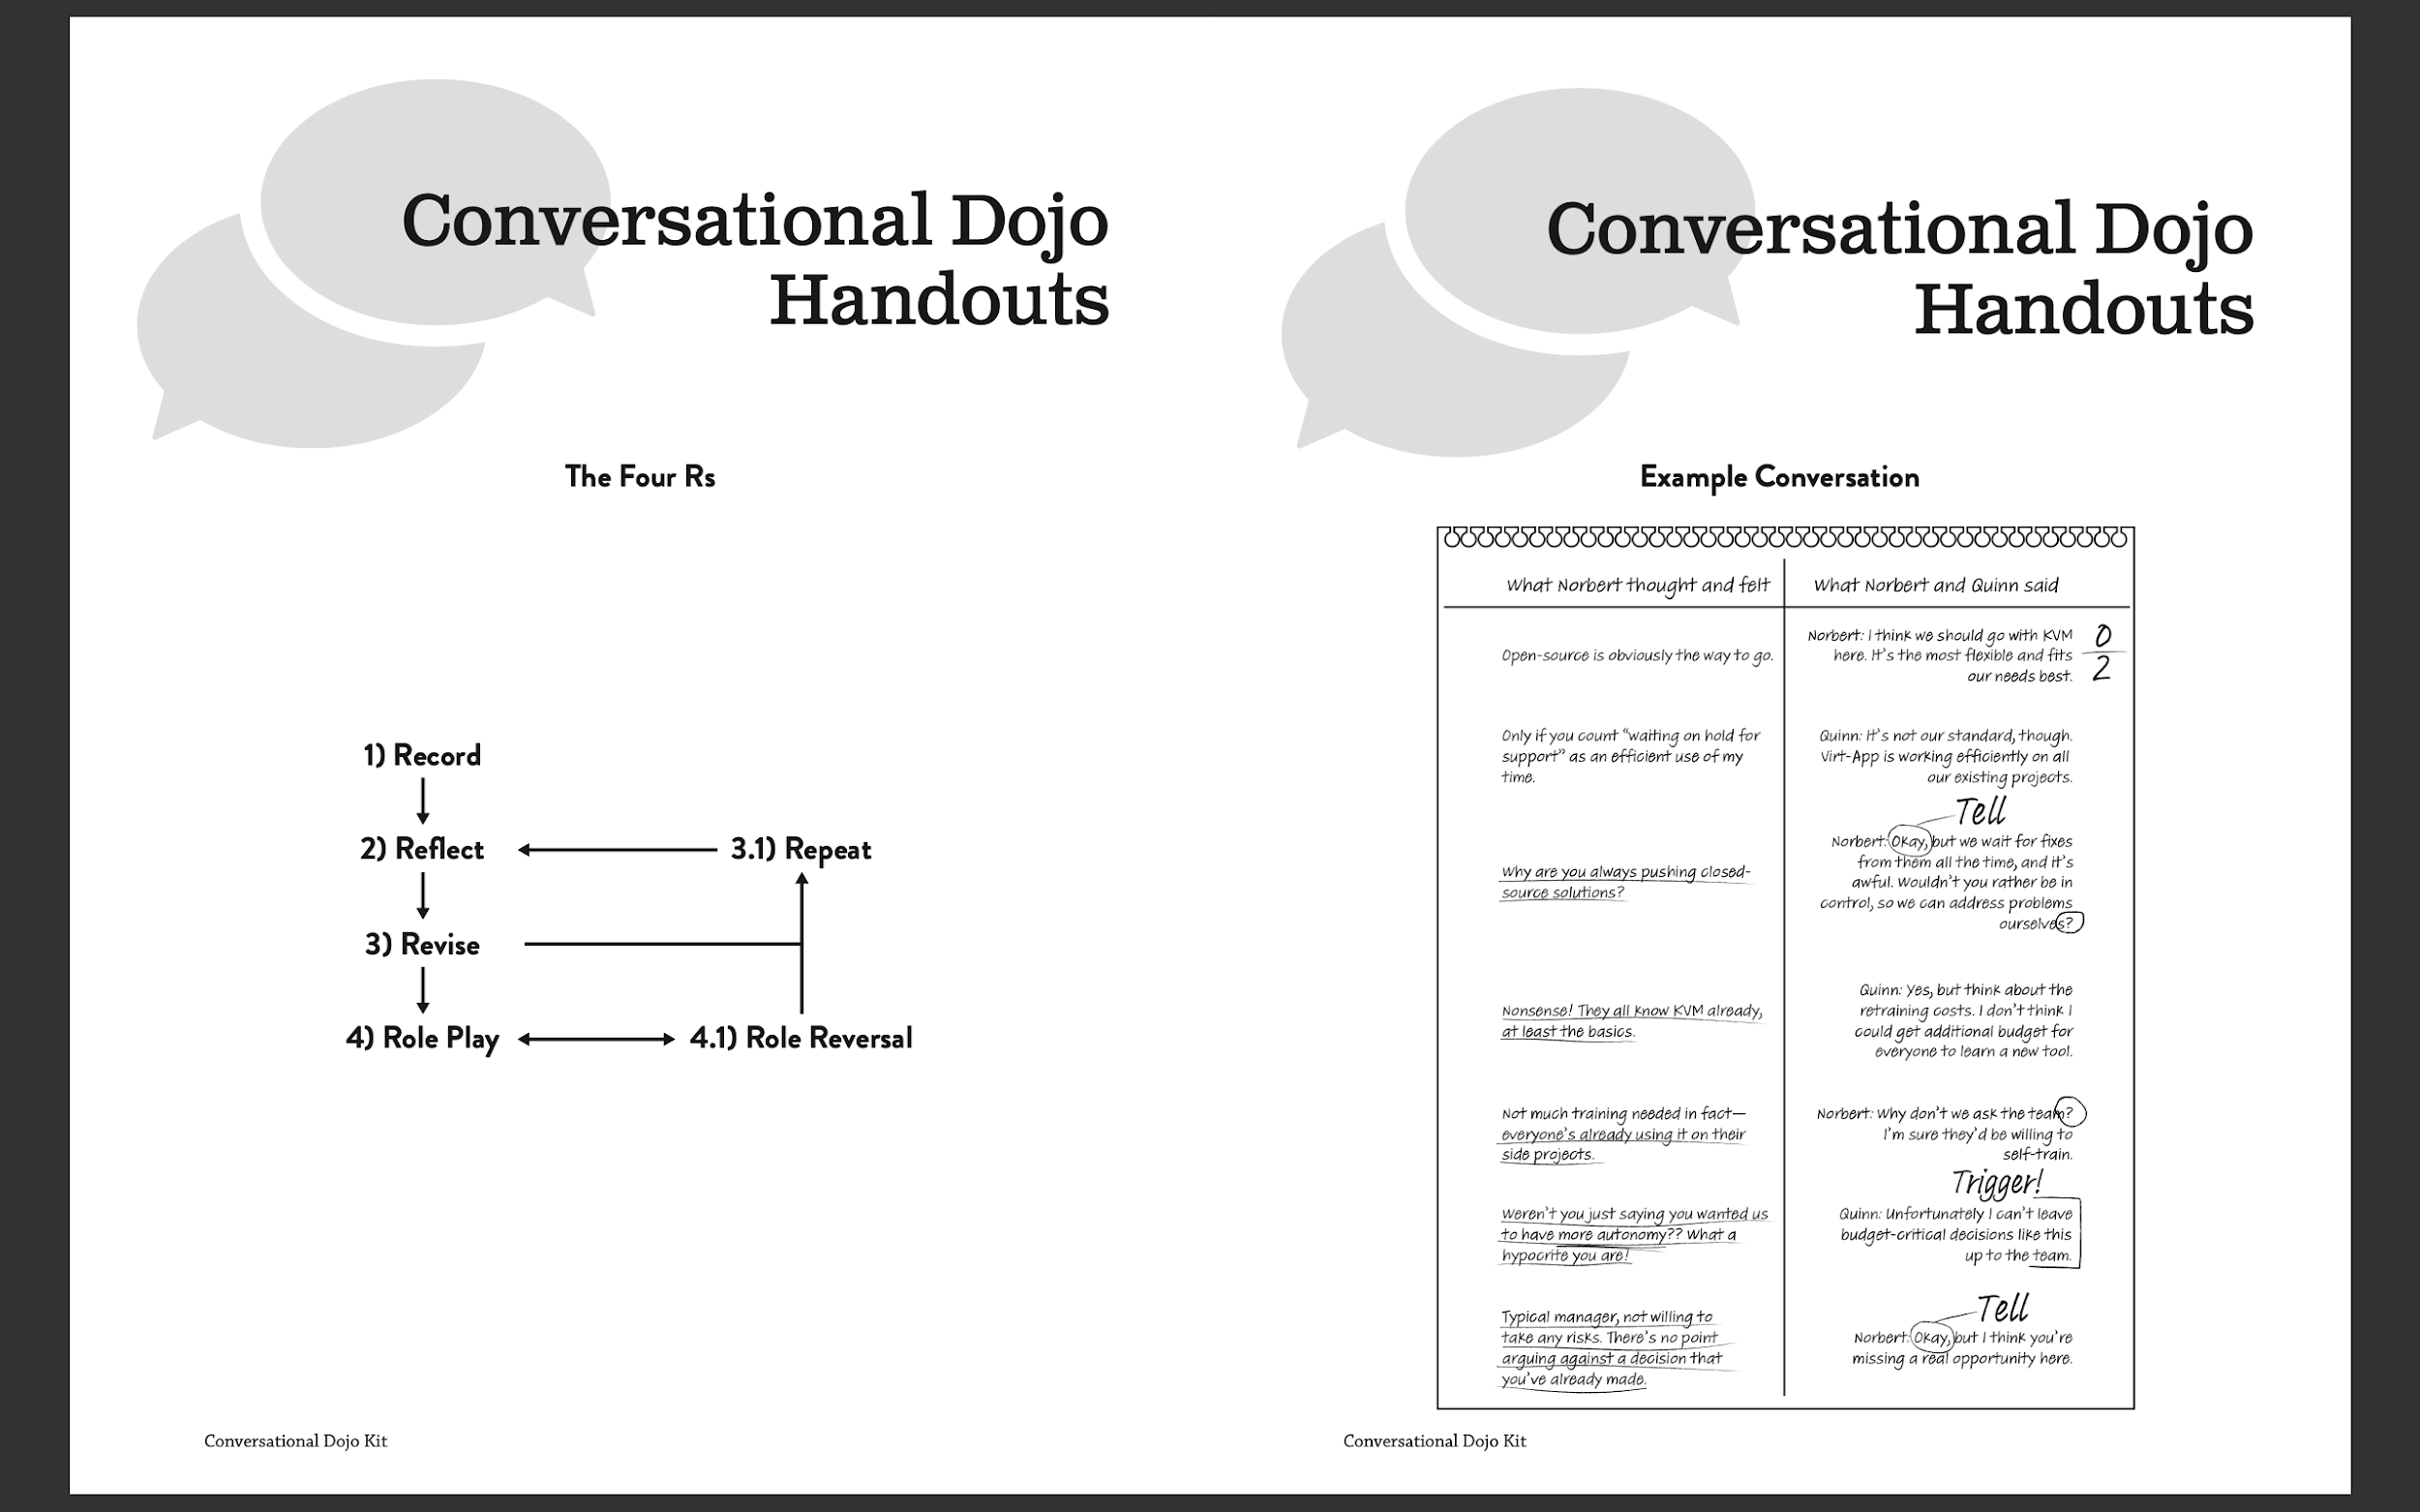
Using the dojo kit
Introduction to Conversational Dojos
Why Form A Conversational Dojo? Types of Dojo Sessions
Dojo Tips
Runbook
Preparing
In the Dojo Session
Handouts
The Four Rs
Example Conversation
Conversation Scoring: A Handy Guide

Slide 17
The Five Conversations
Each conversation comes with techniques, examples, and case studies
Trust - TDD for People (Chris Argyris, The Ladder of Inference)
Fear - Fear Chart (Squirrel/Fredrick)
Why - Joint Design (Chris Argyris)
Commitment - Walking Skeleton (Alistair Cockburn)
Accountability - Briefing and Back Briefing (Bungay, Art of Action)
Takes as long as learning to play a passable game of tennis.
You practice with your everyday work, solving everyday problems.

Slide 18
What’s the Outcome?
Improved relationships
Improved trust
Better decisions
Better leadership
We want you to try these methods, tell us how it helped, and where you get stuck.

Slide 19
Agile Conversations Transform Your Conversations,
Transform Your Culture
Published: May 2020, IT Revolution Press
Available Now
Conversational Dojo Video and Kit
https://itrevolution.com/conversational-dojo-kit-free-download/

Slide 20
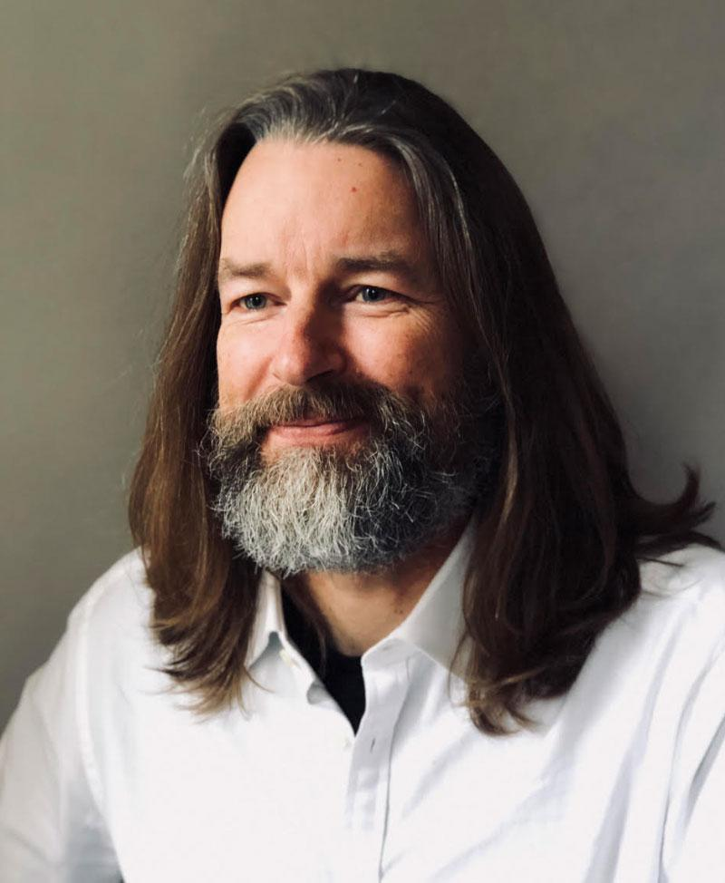
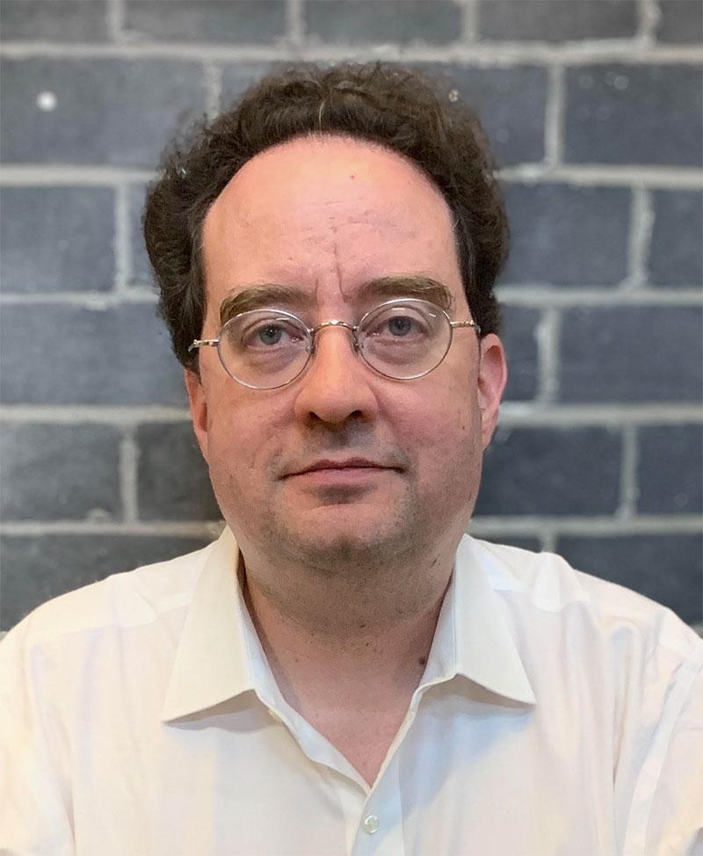

Questions?
https://conversationaltransformation.com
Newsletter : Personalised Advice : Training Workshops
Guided Transformation
Troubleshooting Agile podcast at http://troubleshootingagile.com

